Slide 1

Embedded System Final Presentation
91299482X Lena Mattea Stöxen
61275047H 黃聖崴
61275055H 謝允喆
61275068H 李柏昇

Slide 2

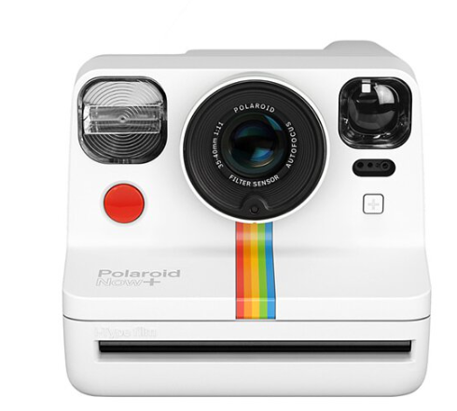

Application Scenarios (Story Line)
With smartphone cameras, capturing 'real' live has become easy
Capturing something unique and different
Retro & Printing Cameras getting more popular
Convenient printing and digital distribution
Fun way to keep a memory

Slide 3
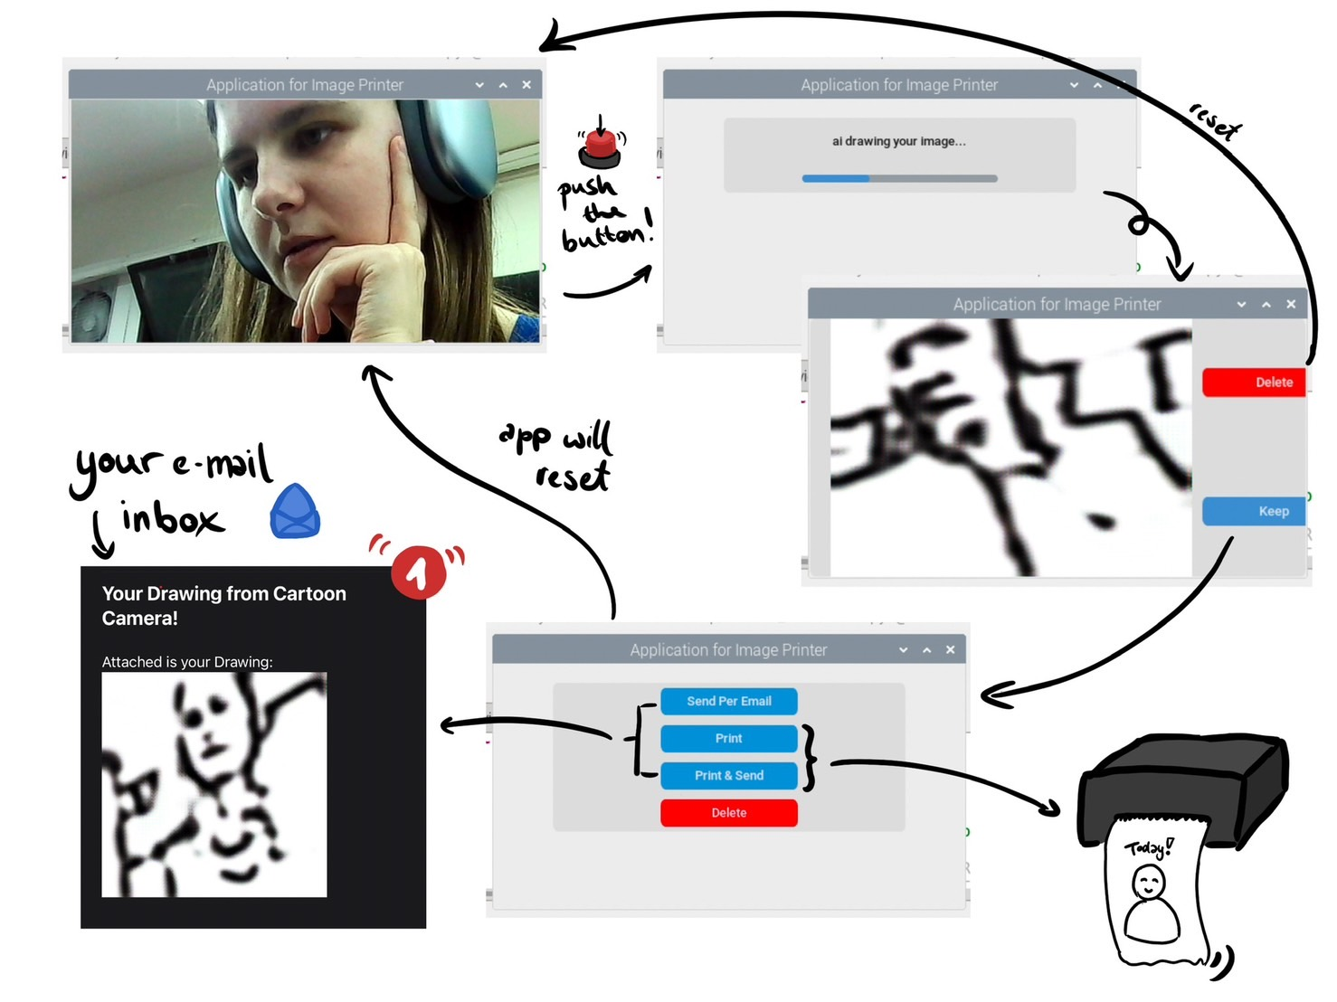
Flow Chart

Slide 4
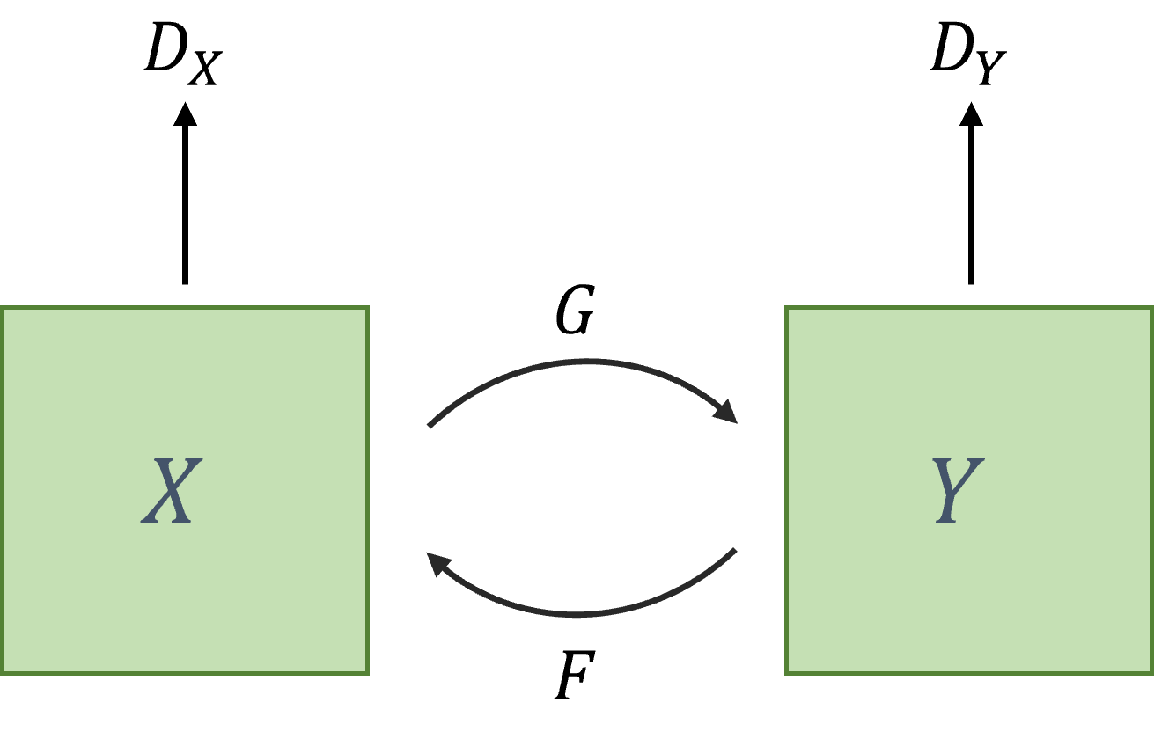
Proposed Model - Cycle GAN
Two Discriminator & Two Generator
Two data distribution(e.g. real image & cartoon image)
real image
cartoon image
Notes:
Discriminator for judging whether the image is generated or original
Generator for generating the fake image to disturb discriminator’s judgement

Slide 5
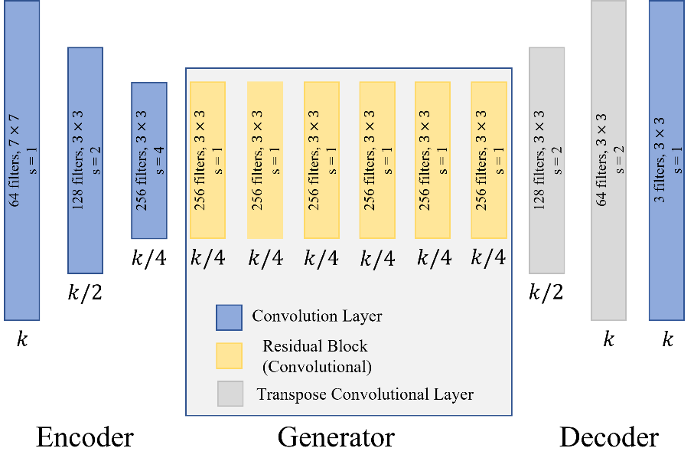
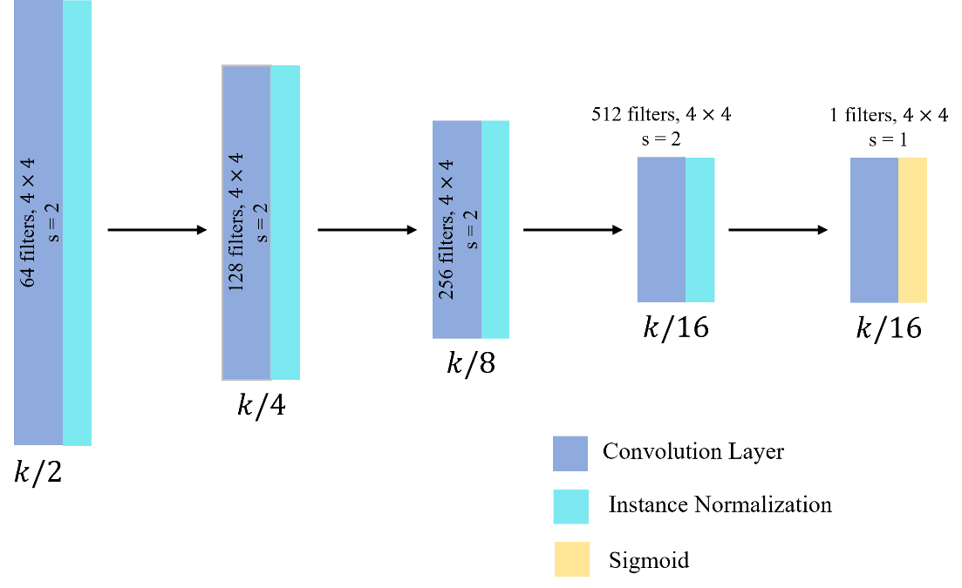
Cycle GAN Model
Generator
Discriminator
PatchGAN
Notes:
In Generator model, it consists of three parts：Encoder part, Generator part and Decoder part.
The Encoder part do the “down-sampling” operation to extract the feature from the image,
the Generator part is composed of six residual Block to keep the image feature and non-linear transformation,
the Decoder part do the “up-sampling” operation to restore the low-resolution image to high-resolution image.
In Discriminator model, usually use PatchGAN model, which will use the convolution layer extract feature by down-sampling operration
and the Fully Connected Layer or Global Average Pooling to give a final decision for classification.

Slide 6
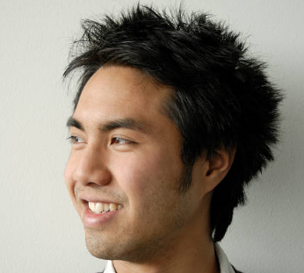
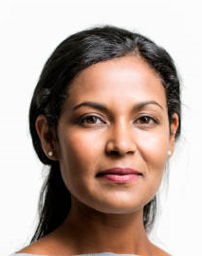
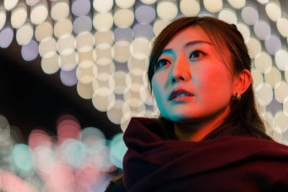


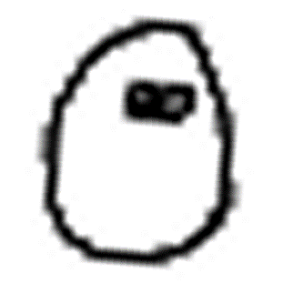


Image Pre-processing
Before feeding the data into the model, we filter out real images with complex backgrounds and defective cartoon images to ensure that the generated cartoon characters have complete facial features.

Slide 7
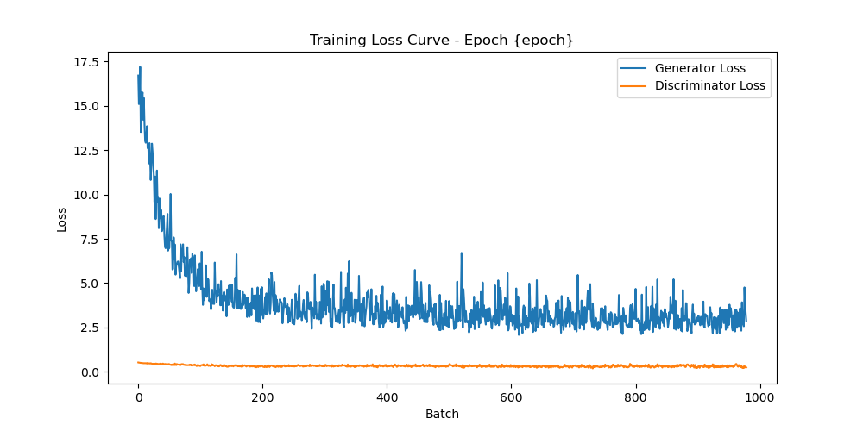
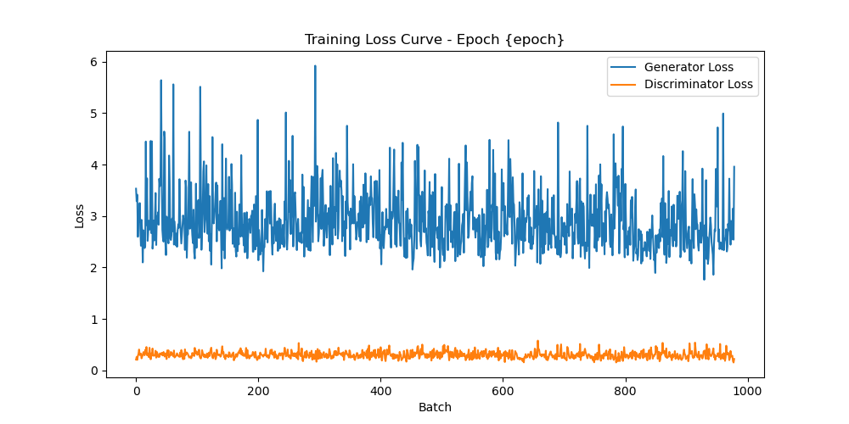
Training & Testing Part
Epoch 0
 | real image | cartoon image
Training Data | 704 | 979
Validation Data | 103 | 198
Testing Data | 200 | 150
Epoch 1
Notes:
The Discriminator loss is caculated by mean square error and the Generator loss is caculated by L1 loss.
The Discriminator loss is both oscillating from the begin to the end, it converges fast.
In Epoch 0, we can observe that the Generator loss in the batch before 200 is decrease drastically and oscillate in the latter batches.
In Epoch 1, it’s the same situation in the latter batches of epoch 0.
The reason why we choose training two epochs for early stopping condition is because of the generated image after two epochs training has the best visualize performance.
In Testing Part, we load the path file from the training part and use the Generator model to generate the cartoon-like images.

Slide 8
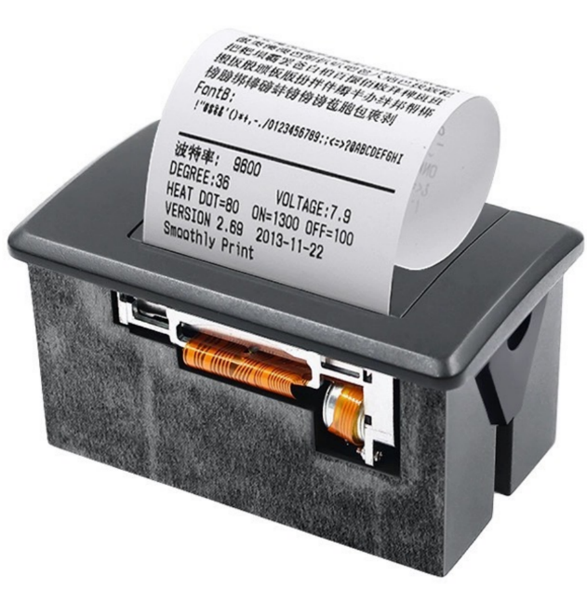
Hardware Block Diagram
Button
(Take a picture)
Camera
Raspberry Pi 4
Printer
(Thermal Printer)
GSM (sent email)
Touch Screen
(3.5 inch RPI LCD)

Slide 9
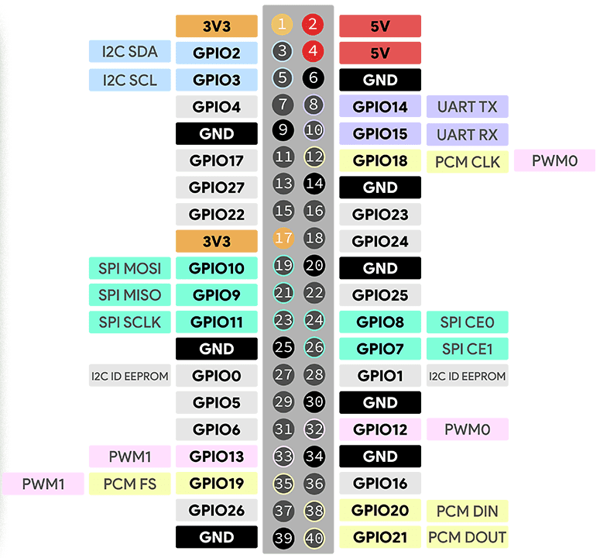
Pin-Set Connection
LCD : Pin 1、2、6、9、11、14、17~26 Button : Pin 37、39
Printer : Pin 4、8、10、34
LCD
Button
Printer

Slide 10
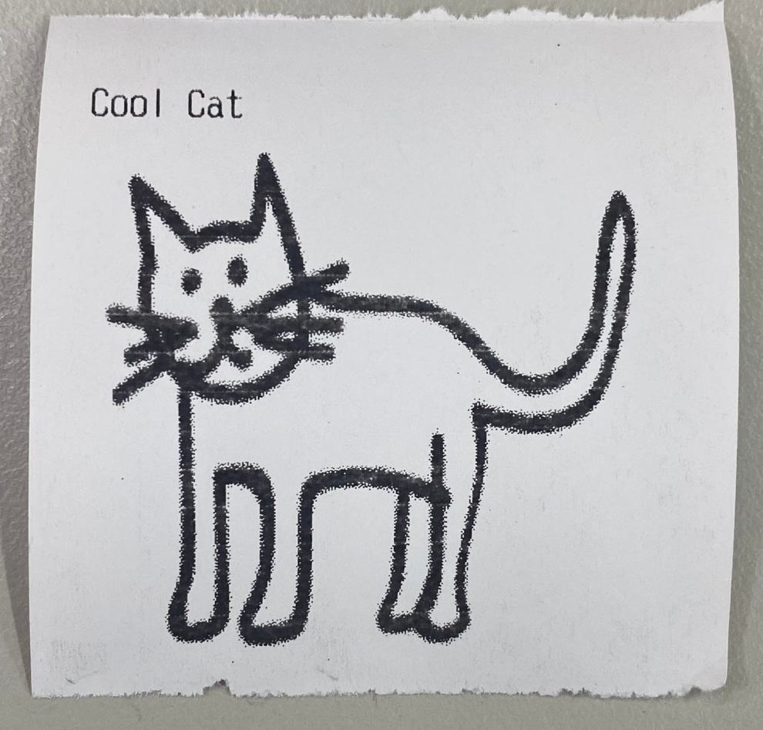
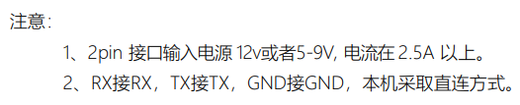
Thermal Printer paper
Using heating head-on thermal papers to produce images.
TTL mode for connected the pin set
Enable the Hardware Serial through raspi-config
Working on ESC/POS command to use the dedicated library
Notes:
A thermal printer is a printer that uses heating head-on thermal papers to produce images. Its quality of print, ease of installation, minimum use of external components, and low power consumption, makes it more popular among token or , grocery stores, tiffin centers, entertainment centers, corporate industries, etc.
TTL mode for connected the pin set
Enable the Hardware Serial through raspi-config
This thermal printer works on ESC/POS command for which we will be using the dedicated library

Slide 11
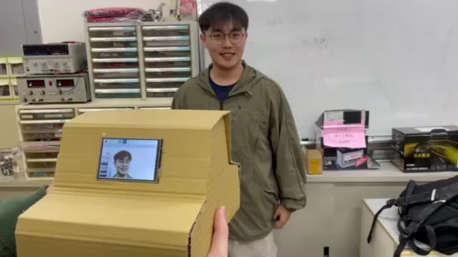
Demo
Notes:
A thermal printer is a printer that uses heating head-on thermal papers to produce images. Its quality of print, ease of installation, minimum use of external components, and low power consumption, makes it more popular among token or , grocery stores, tiffin centers, entertainment centers, corporate industries, etc.

Slide 12
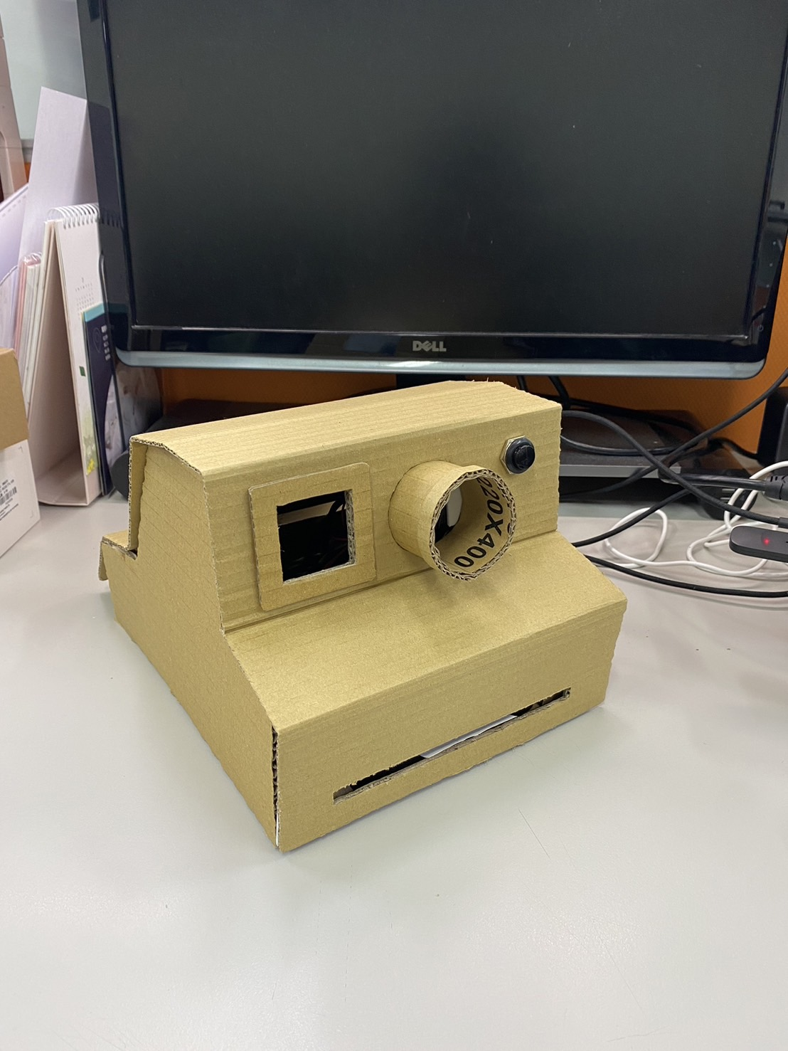
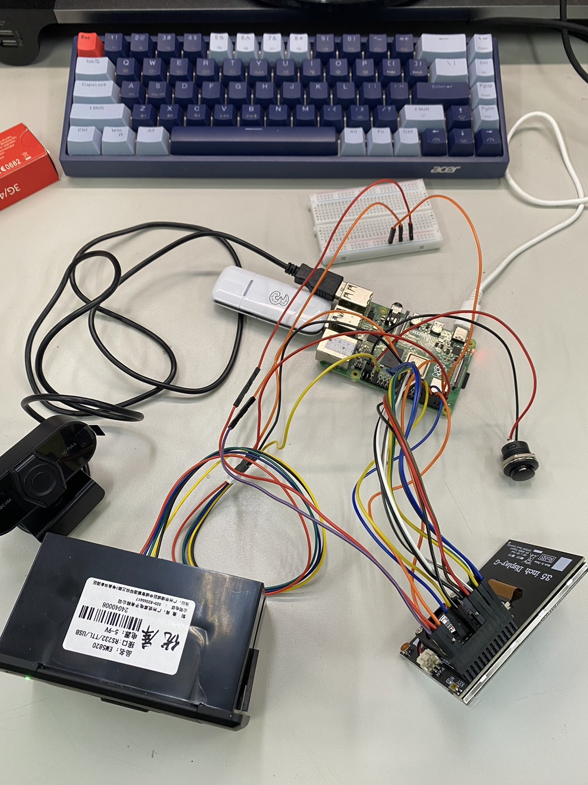
BOM (Bill of Materials)
Name | Serial number
Raspberry Pi | Raspberry Pi 4 Model B (2 GB RAM)
SD Card | SanDisk Ultra microSD UHS-I 64GB
USB Camera | Raspberry Pi Camera Module V2
Dupont Line | Dupont Line
Breadboard | Breadboard
Micro HDMI/HDMI | Micro HDMI/HDMI
Button | r13-507 push button switch
Thermal Printer | Yokoscan EM5820 58mm Thermal Kiosk Printer
Touchscreen | 3.5inch Resistive Touch Display
Thermal Printer paper | 57mm*40mm thermal Printer paper
GSM | UAWEI Mobile Broadband
Notes:
A thermal printer is a printer that uses heating head-on thermal papers to produce images. Its quality of print, ease of installation, minimum use of external components, and low power consumption, makes it more popular among token or , grocery stores, tiffin centers, entertainment centers, corporate industries, etc.

Slide 13
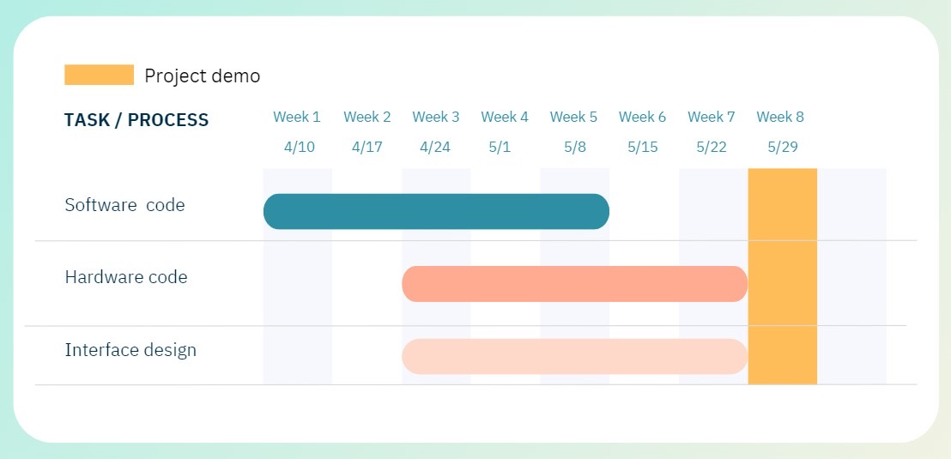
Breakdown of Job Assignment & Gannt Chart
Work | 李柏昇 | 黃聖崴 | 謝允喆 | Lena
Find model | ☑ | ☑ | ☑
Find dataset |  | ☑ | ☑ | ☑
Image Pre-processing |  |  | ☑
Hardware code | ☑ | ☑
Software code |  | ☑ | ☑
User interface design |  |  |  | ☑
Outlook View | ☑

